Slide 1
Software Development with UML and Java 2

Slide 2
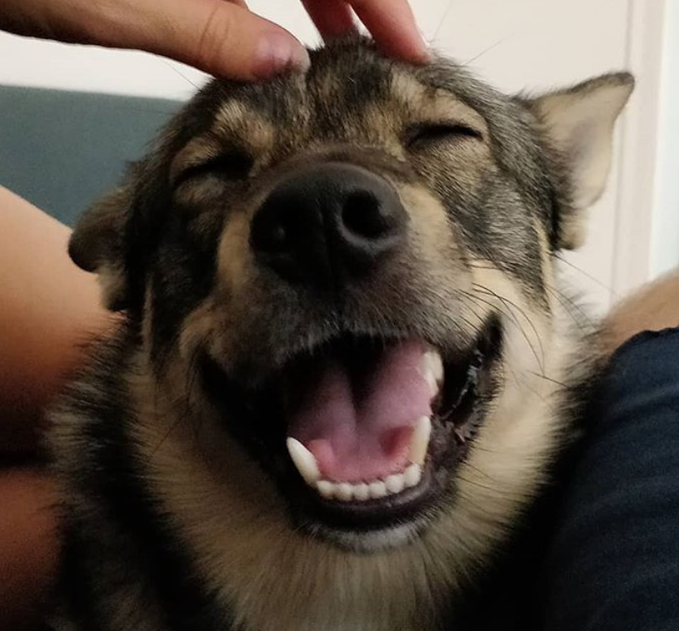
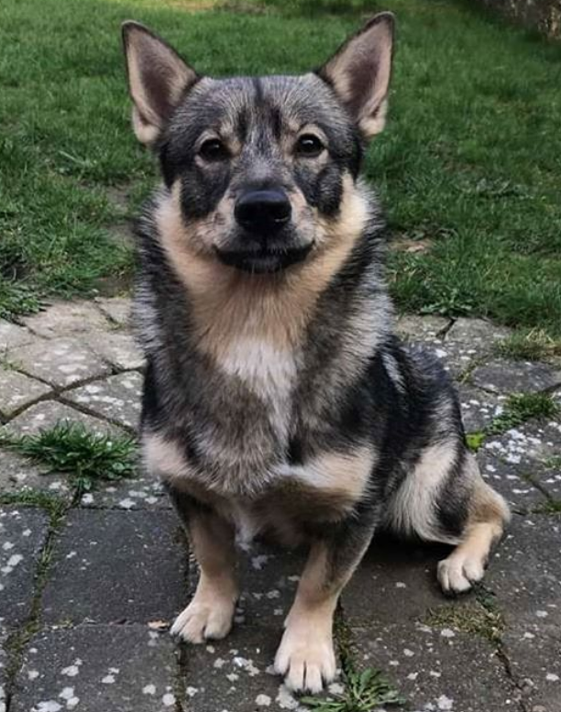
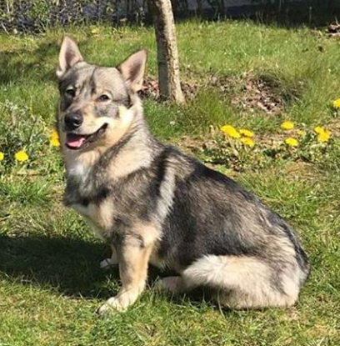
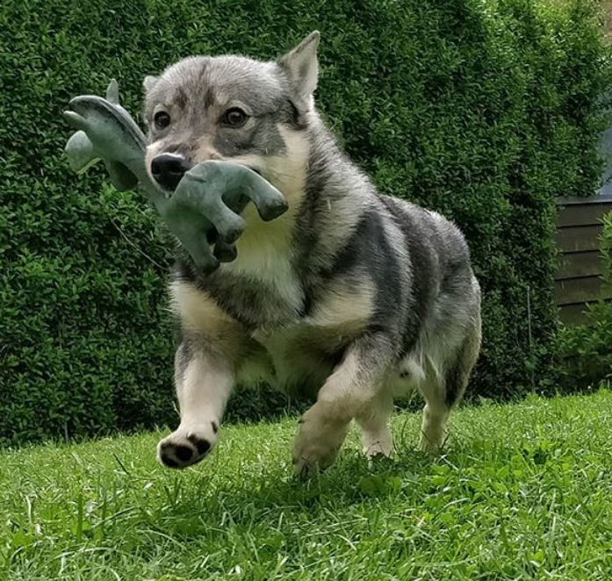
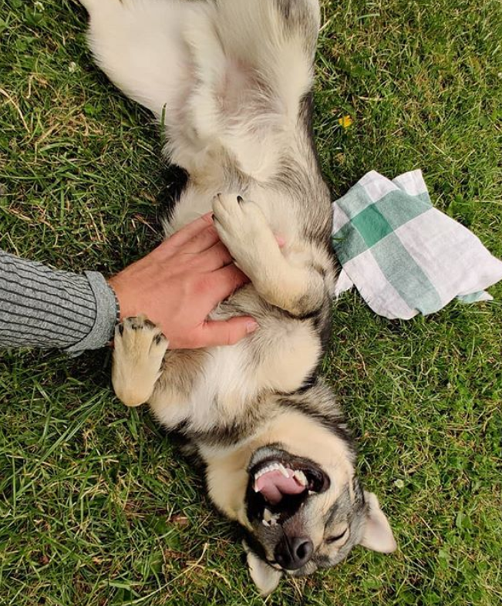
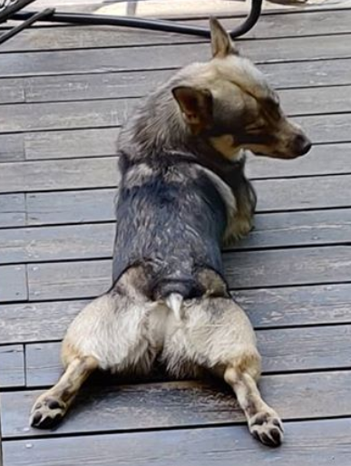
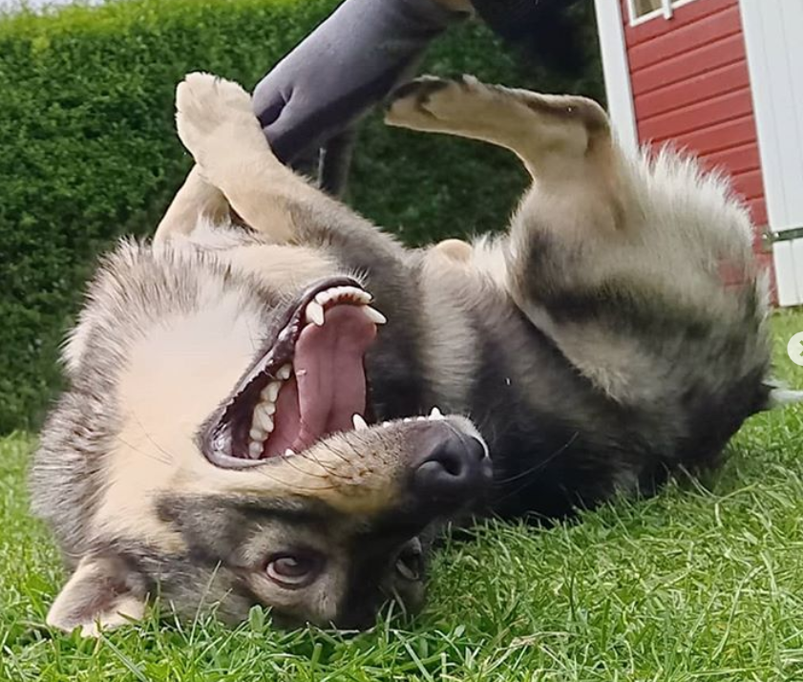
Sorry about Tuesday

Slide 3
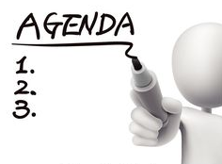
Today’s
Introduction
All kinds of practical info
Multithreading

Slide 4
Practical info
Who am I?
Troels Mortensen
trmo@via.dk
A.301b

Slide 5
Practical info
What is SDJ2?
Continuation of SDJ1
More advanced programming, designing software systems
Presentation + exercises (¼ + ¾)
Time:
Tuesday 8:20-11:50, 4 lessons
Friday 8:20-11:50, 4 lessons
Course home page
Find it on itslearning
Homework:
10 ects = 250h of work.
~96h of classes ➔ 154h of homework

Slide 6
Small game, part 1
When I say go, write the following on a piece of paper.
One character, then a comma, then a character, then a comma. First all numbers, then all letters.
When you’re done, look at the stop watch, note you time.
1, 2, 3, 4, 5, 6, 7, 8, 9, 10, 11, 12, 13, 14, 15, 16, 17, 18, 19, 20
A, B, C, D, E, F, G, H, I, J, K, L, M, N, O, P, Q, R, S, T, U, V, W, X, Y, Z
α, β, γ, δ, ε, ζ, η, θ, ι, κ, λ, μ, ν, ξ, ο, π, ρ

Slide 7
House rules

Slide 8
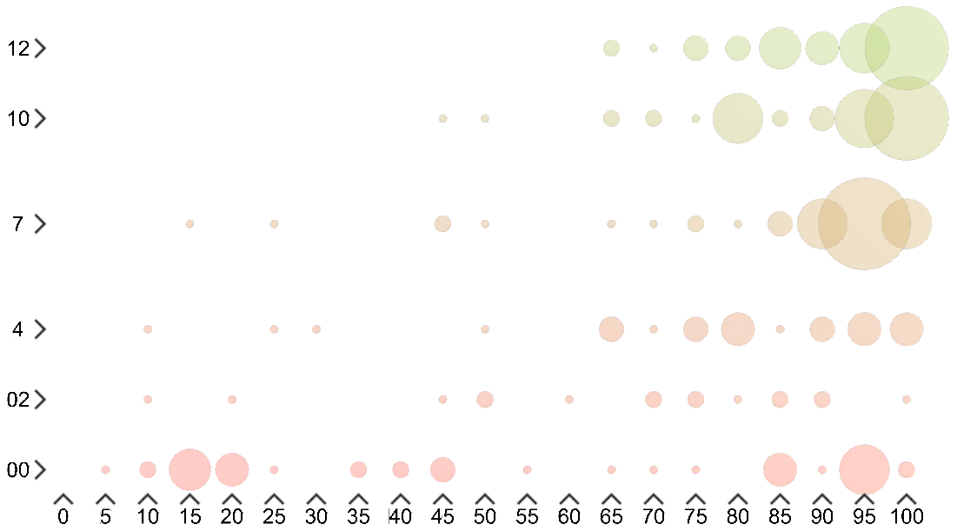
185 students
, largest bubble represents 6 grades.

Slide 9
How do we fix this part?
Fixing this part ?

Slide 10
Mandatory attendance
Above 75% to go to the exam. Just like SDJ1.

Slide 11

Who’s here?

Slide 12
Who takes notes during the presentation?
Pen and paper?
Laptop?

Slide 13
Small game, part 2
When I say go, write the following on a piece of paper.
One letter, then a comma, then a number, then a comma, then a Greek letter, then a comma, letter, comma, number, comma. Switching between numbers and letters and Greek letters.
When you’re done, look at the stop watch, note your time.
1, 2, 3, 4, 5, 6, 7, 8, 9, 10, 11, 12, 13, 14, 15, 16, 17, 18, 19, 20
A, B, C, D, E, F, G, H, I, J, K, L, M, N, O, P, Q, R, S, T, U, V, W, X, Y, Z
α, β, γ, δ, ε, ζ, η, θ, ι, κ, λ, μ, ν, ξ, ο, π, ρ

Slide 14
What was the point of this again?

Slide 15

How do we fix this part?
Fixing that part ?

Slide 16
Code of Conduct - for participating in classes
Defined by the big bosses of the engineering education
Gør tanke til handling
VIA University College
At VIA Engineering, we have four simple rules for participating in classes:
Be on time.
Lecturers and classmates rely on you and class often starts with important information.
Be active.
Take part in discussions and exercises. Which means no Social Media, gaming etc. in class - it disturbs others and takes away your own focus.
Be prepared.
Preparation is an essential part of learning. If you are not prepared, you will not be able to participate effectively in the class.
Stay focused.
Start the class with the computer closed until the teacher says it is okay to use computers. Leave your phone and devices in your bag on silent mode.

Slide 17
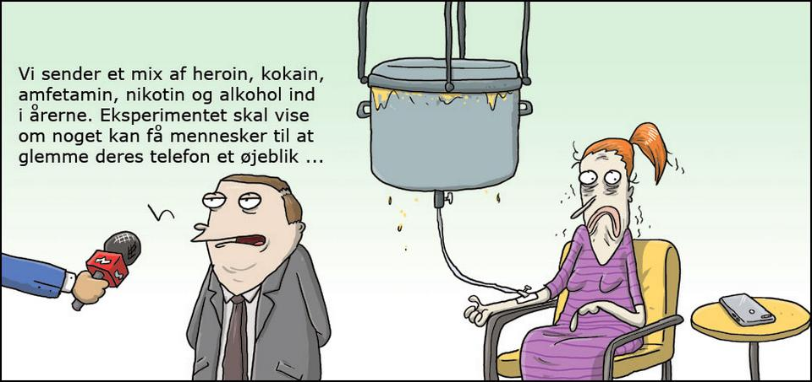
Code of Conduct - for participating in classes
Gør tanke til handling
VIA University College
At VIA Engineering, we have four simple rules for participating in classes:
Be on time.
Lecturers and classmates rely on you and class often starts with important information.
Be active.
Take part in discussions and exercises. Which means no Social Media, gaming etc. in class - it disturbs others and takes away your own focus.
Be prepared.
Preparation is an essential part of learning. If you are not prepared, you will not be able to participate effectively in the class.
Stay focused.
Start the class with the computer closed until the teacher says it is okay to use computers. Leave your phone and devices in your bag on silent mode.
We’re injecting a mix of heroin, cocaine, methamphetamine, nicotine, and alcohol into the veins. The experiment aims to show if it can make people forget their phones for a few seconds

Slide 18
Pay attention, you’re here to learn.
When class starts, laptops are closed. You’re not going to need them during the presentation. It just disturbs your fellow students, if you’re doing other stuff.
If you’re late, and the door is closed, you wait outside until the next break…?
You’re here to study, please do that. Games and other stuff can be done outside of class.
Phones on silent, out of sight.

Slide 19
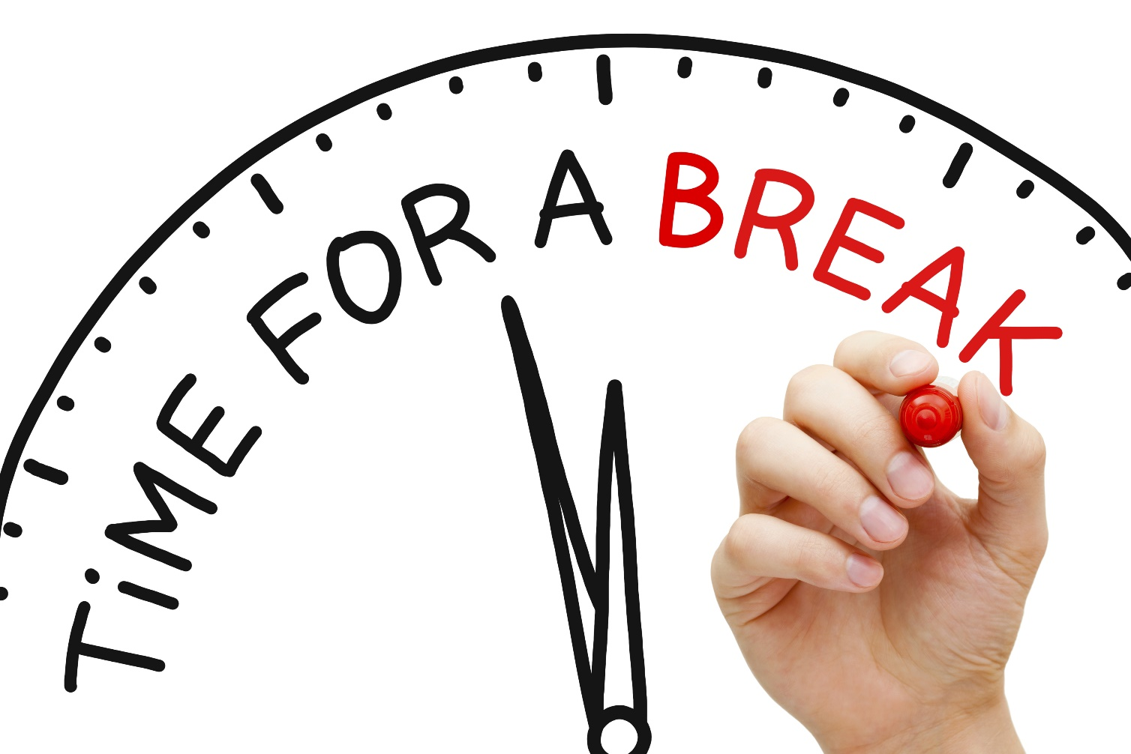
Manage your own breaks during exercises.
If you need a break during presentations, let me know. I’ll just go on and on and on and on and on and on and on and …

Slide 20


Slide 21
Programming workshop 2 (WS2)
Is anyone interested?
Or some kind of study group with an instructor.

Slide 22
Software
IDE
Eclipse, or
IntelliJ (Link – select Community edition, or setup an account and use student license)
SDK
Java 11 (Link)
JavaFX (Link)
Scene Builder 10 (Link)

Slide 23
Topics of SDJ2
What you’re going to (hopefully) learn in this course.
Why?
Client/Server technology: RMI and sockets
Design patterns
Multithreading
Testing

Slide 24



Semester project
Client/Server technology: RMI and sockets
Design patterns
Multithreading
Testing
Client-server system
(with a database)
We need to make multiple computers communicate
client
client
server
database

Slide 25
Semester project
Client/Server technology: RMI and sockets
Design patterns
Multithreading
Testing
Client-server system
(with a database)
client
Large systems needs to well structured
client
Large systems needs to well structured
server

Slide 26
Semester project
Client/Server technology: RMI and sockets
Design patterns
Multithreading
Testing
Client-server system
(with a database)
client
client
Serving multiple clients requires multithreading.
server

Slide 27
Semester project
Client/Server technology: RMI and sockets
Design patterns
Multithreading
Testing
Client-server system
(with a database)
client
client
We need to make sure, we deliver a working, bug-free system
server

Slide 28
There’s something I don’t understand. What do?
ASK!

Slide 29


Slide 30
Course plan
Everything is on itslearning.
Notice this is last semester’s material, which will be updated slightly as we move along.

Slide 31
Exam
Oral exam, 15 minutes
Based on assignment during the semester
You explain theory and show prepared code examples, based on the assignment.
No live coding.
In order to go to the exam:
Three assignments must be handed in and approved.
Above 75% attendance.

Slide 32

Week 42
Vacation
No mid-semester exam on 2nd semester.
D

Slide 33
